Slide 1
COM2501 Dıgıtal ımage processıng project
Hüseyin Yorğa
Berkay Yıldız

Slide 2

Content table
Functions
Uicontrols

Slide 3
functıons

Slide 4
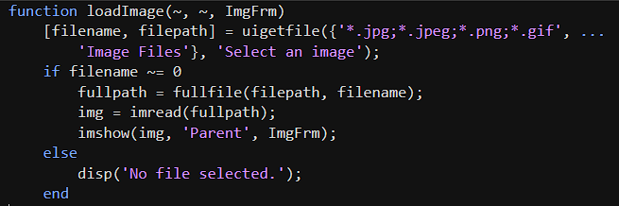
Load Image Function
In load image function, function takes photo files from user, and displays it left side of program.

Slide 5
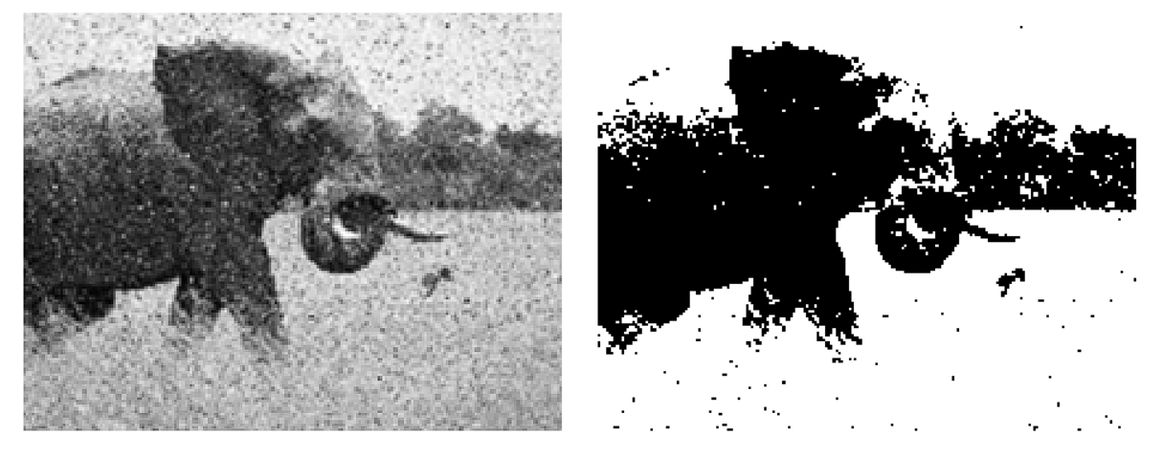
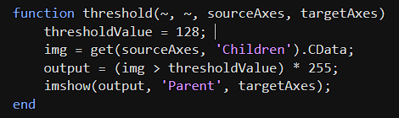
Threshold Function
In threshold function, there is a threshold value like 120. Threshold function iterates through all pixels on photo, and if rgb color value below 120, it changes the value as 0. If rgb color value above 120, it changes the value as 255.

Slide 6
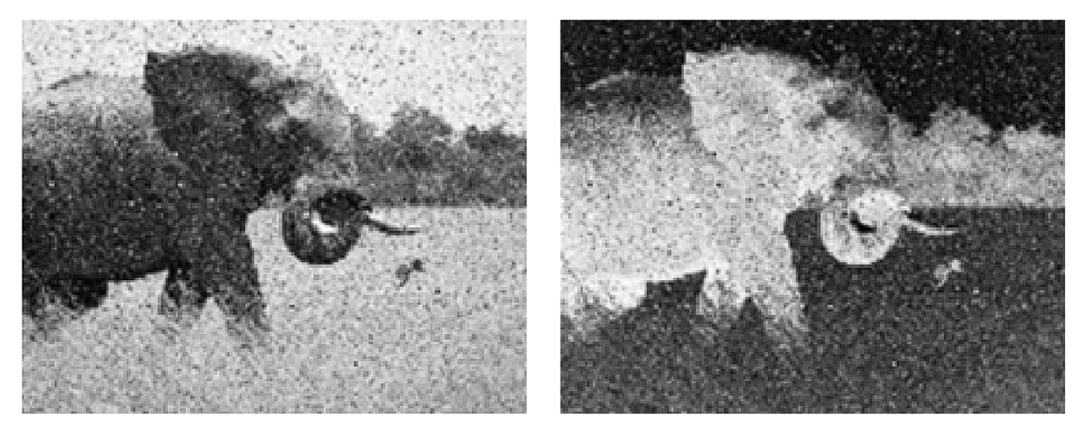
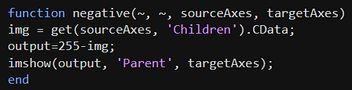
Negative Function
In negative function, function iterates through all pixels of photo and changes color value as 255-color value.

Slide 7
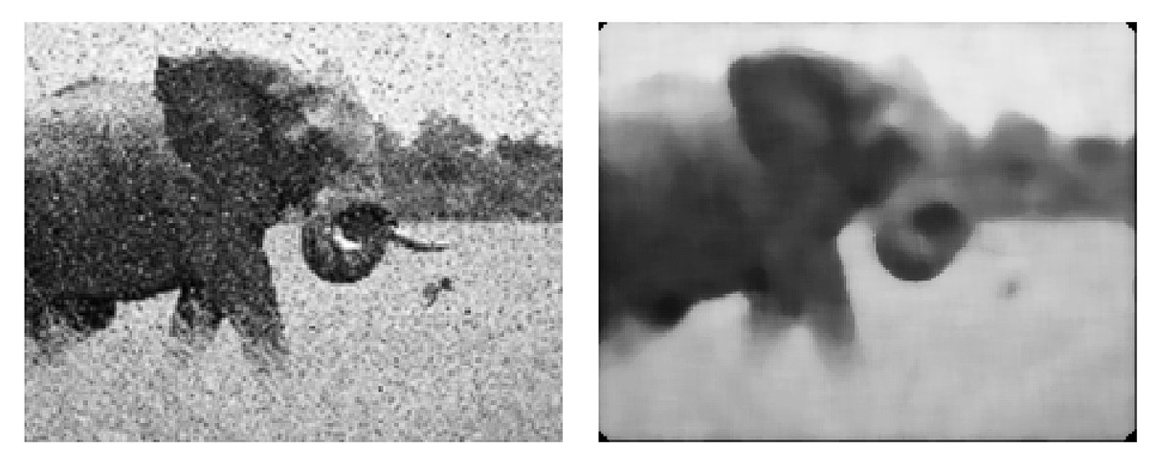
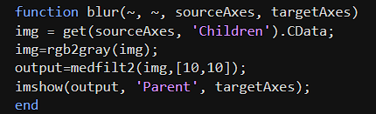
Blur Function
In negative function, function iterates through all pixels of photo, and applies a 10 to 10 median filter.

Slide 8
UICONTROLS

Slide 9
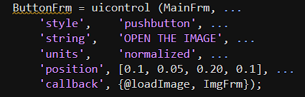
UICONTROLS - Buttons
Buttons are used to apply functions. Buttons have some features like style, string, position, callback, units.
Style feature specialise the button.
String feature appears a string on the button.
Callback feature takes function and photo and apply function to the photo.

Slide 10
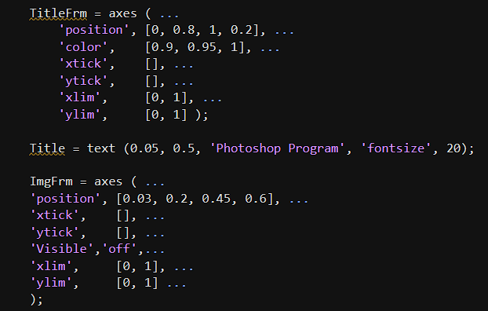
UICONTROLS - Frame
Frames are used to set limits on the program.

Slide 11




Teşekkürler
Hüseyin Yorğa (21290339)
Berkay Yıldız (21290303)

